Slide 1


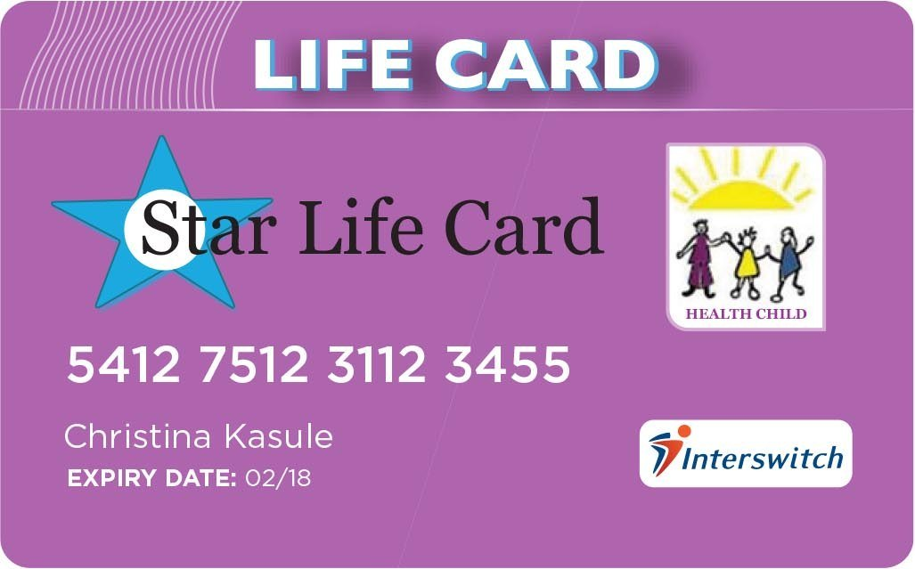

Slide 2

Introduction to Health Child
Facts about Health financing in Uganda
Star life card ( features, functions, how it works)
The Card & access to health care
The card & saving for health
Results so far
Limitations

Slide 3

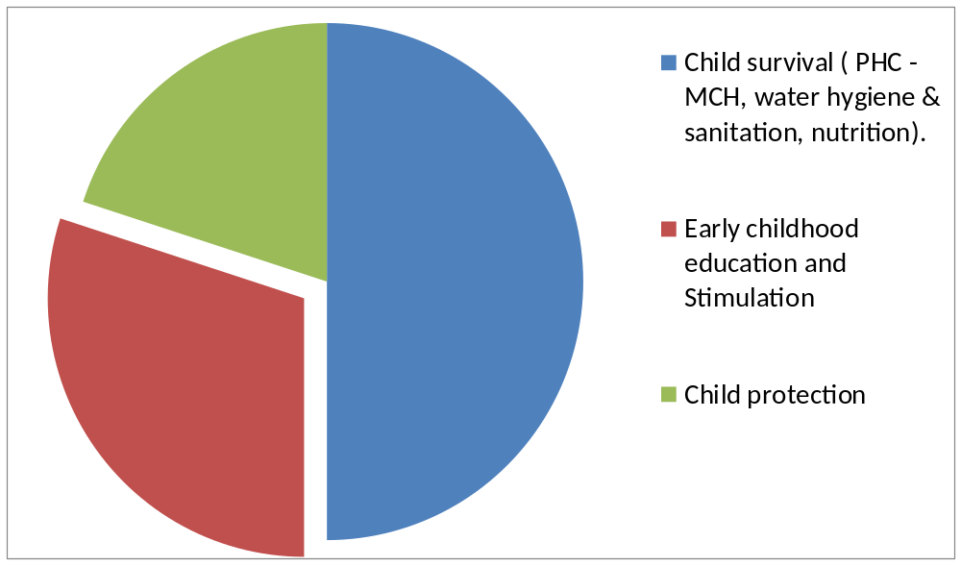
Health Child is a registered NGO in Uganda founded in 2006. Projects are broadly clustered around three core programmes : Child Survival, early childhood education and child protection.

Slide 4

Although health care is perceived to be free, 46% of Ugandan seek care from private facilities (UDHS 2006 & 2011)
A Ugandan spends 22% of their income on health
6% of the poorest have to sell assets to access care
Uganda has no national health insurance scheme in place
only 1% of Uganda have access to formal health insurance

Slide 5
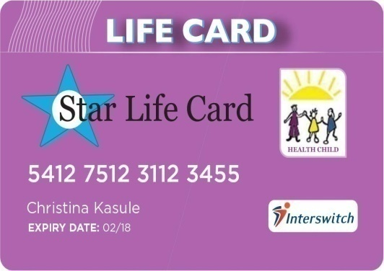
Key features of the card
Digital smart card that allows holders/ owners to save money for health and access health services and products at participating health centres/hospitals or pharmacies.
Card Features
Requires a pin
Built on rural technology compatible with POS machines
Can send sms for statement

Slide 6



How a person gets the card
Health Child processes the card and the client starts to save on the card
Client ‘ s bio data is captured
Person goes to Star Life Agent Points
Person goes for treatment with the card
2. How the Card works at a health facility
Star Life Services available here

Slide 7

How a health centre gets their money
Star Life Services available here

Slide 8

Reduces delays in decision making associated with lack of ready finances to spend on health.
Reduces delays associated with giving health care associated with lack of money on the side of patients.
Reduces risk of self-medication associated with lack of finances at the time of falling sick.
reduced cost of care (subsidies from collaborating health facilities)

Slide 9

The card instigates a culture of saving for health
Saving money on the card in a non transferable form safeguards saving earmarked for health from other competing expenditure demands

Slide 10
At base line 3100 respondent in the pilot & control district were interviewed.
Only 288 (9.3%) & 286 (9.2%) respondents respectively were in some form of saving for health.
An increment of 17% & 9.6% was seen by the end of 2015th (sample of 1200)
Card holding has risen from 0 at baseline to 1700
Approximately 45,000 us dollars has been saved on the platform

Slide 11
42.3% have loaded money on the card 8 or more times,16%) 5-7, 24% 1-5 and 17.7% never
33% of the active card holders have used the card to access health care 5 or more times, 41% two-four times, 24% once and 2% none

Slide 12
240 women that had given birth 6 months prior to the card were interviewed:
4th ANC visit 35.6%, skilled deliveries 76% and PNC28%
in Aug 2016. 240 card holders were interviewed: ANC 4th visit 92%, facility deliveries 95.6% and PNC 68%

Slide 13
technology infrastructure costs
Requires heavy investment in awareness creation
Requires heavy subsidization
requires a well spread network of agents
sabotage parallel free for service projects
lack of guiding polices

Slide 14

Thank you all for being such a wonderful audience,

